Slide 1

A Generalized TanhExp Activation Function with a Variable Exponential Base for Deep Neural Networks
DEPARTMENT OF MATHEMATICS AND STATISTICS
COLLEGE OF COMPUTER SCIENCE & INFORMATION SYSTEMS (CCSIS)
INSTITUTE OF BUSINESS MANAGEMENT (IOBM)
Presented by:Muhammad Umair Arif (20242-35517)
Supervised by:Dr. Faiza RubabYousuf (Assistant Professor CCSIS, IoBM)
Co-Supervised by: Dr. Urooj Yousuf (Assistant Professor CCSIS, IoBM)

Slide 2
Presentation Outline
Introduction
Literature Review
Problem Statement
Objectives of the Study
Research Questions
Methodology
Results & Discussion
Contribution of the Study
Limitations
Future Work
References
Suggestion

Slide 3
Introduction and Backbround

Slide 4
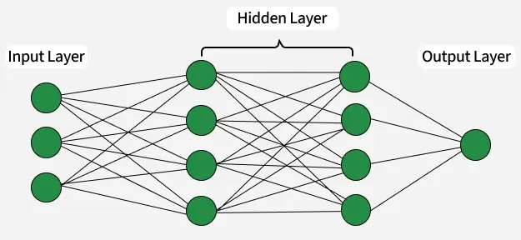
Background
Neural Networks
Neural Networks are machine learning models inspired by the way the human brain processes information.
They consist of interconnected layers of neurons that learn patterns from data and make predictions.
A neuron receives inputs, applies weights and bias, and produces an output.
Deep neural networks (DNNs) contain multiple hidden layers for learning complex patterns.
Neural networks are widely used for classification, prediction, and pattern recognition.

Slide 5
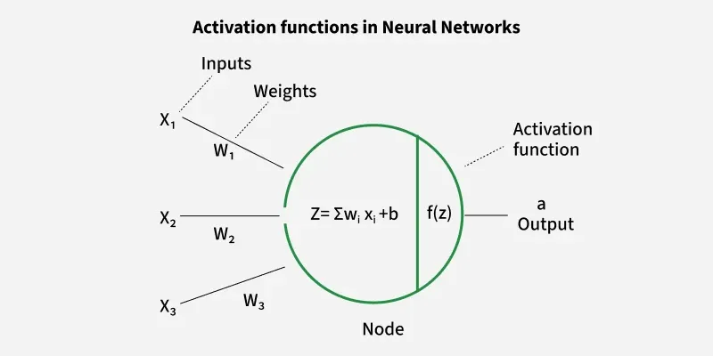
Background
Activation Functions in Deep Learning
An activation function is applied to the weighted sum of inputs before producing the final output of a neuron
It introduces non-linearity, allowing the network to learn complex patterns.
Their mathematical properties affect gradient propagation, learning behavior, and convergence.

Slide 6
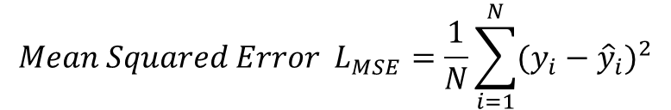
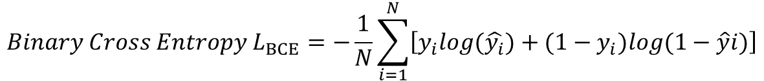
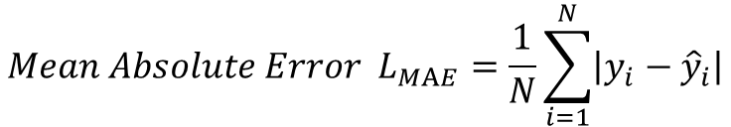
Background
Loss function in Neural networks
The loss function measures the difference between the predicted output and the actual target.
It provides a numerical measure of the prediction error.
Different types of losses are:
$$Mean Squared Error L_{MSE}=\frac{1}{N}\sum_{i=1}^{N}{(y_{i}−{\hat{y}}_{i})^{2}}$$
$$Mean Absolute Error L_{MAE}=\frac{1}{N}\sum_{i=1}^{N}{\left|y_{i}−{\hat{y}}_{i}\right|}$$
$$Binary Cross Entropy L_{BCE}=−\frac{1}{N}\sum_{i=1}^{N}{\left[y_{i}log(\hat{y_{i}})+(1−y_{i})log(1−\hat{y}i)\right]}$$
During training, the main goal is to minimize the loss

Slide 7

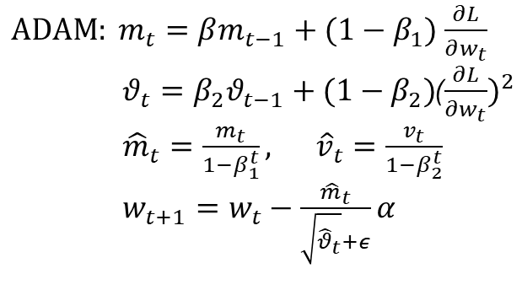
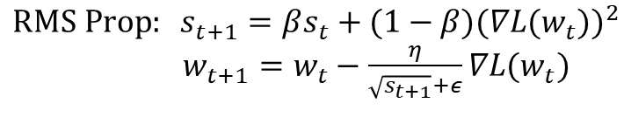
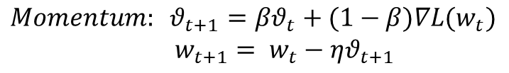
Background
Optimization in Neural networks
Training a neural network involves minimizing a loss function.
Optimization algorithms update network parameters using the gradient of the loss function.
Common Optimizers include:
$$RMS Prop: s_{t+1}=βs_{t}+(1−β)(∇L(w_{t}))^{2}$$
$w_{t+1}=w_{t}−$ $\frac{η}{\sqrt{s_{t+1}}+ε}∇L(w_{t})$
$$Gradient Descent: w=w−α\frac{∂L}{∂w}$$
$ADAM: m_{t}=βm_{t−1}+(1−β_{1})$ $\frac{∂L}{∂w_{t}}$
$θ_{t}=β_{2}θ_{t−1}+(1−β_{2})$($\frac{∂L}{∂w_{t}})^{2}$
${\hat{m}}_{t}=\frac{m_{t}}{1−β_{1}^{t}}, {\hat{v}}_{t}=\frac{v_{t}}{1−β_{2}^{t}}$
$w_{t+1}=w_{t}−\frac{{\hat{m}}_{t}}{\sqrt{{\hat{θ}}_{t}}+ε}α$
$$Momentum: θ_{t+1}=βθ_{t}+(1−β)∇L(w_{t})$$
$w_{t+1}= w_{t}−ηθ_{t+1}$

Slide 8
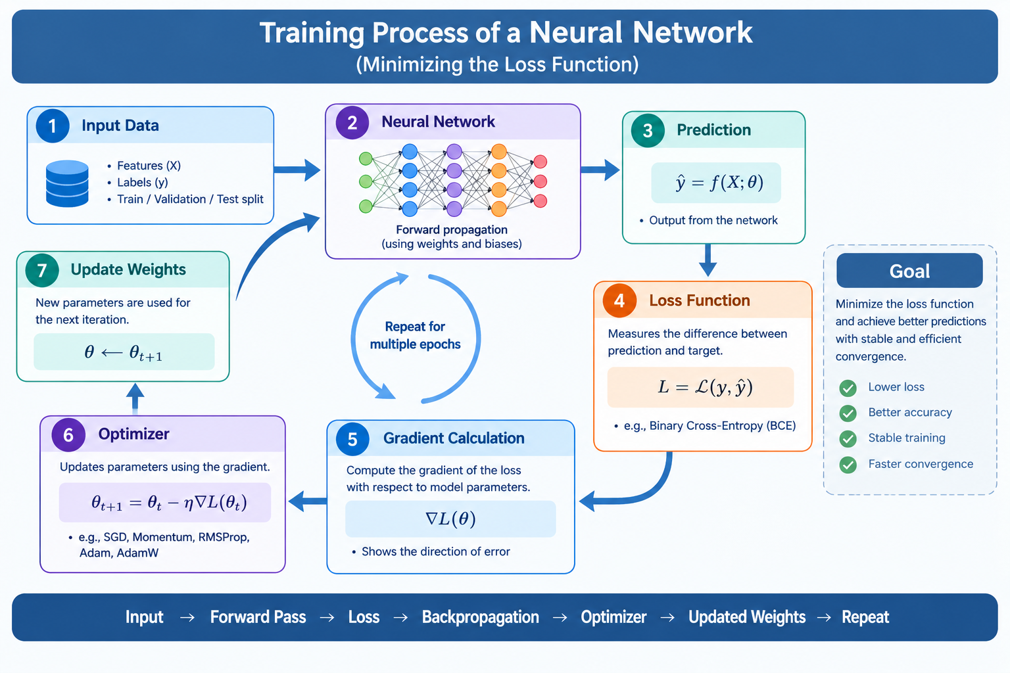

Slide 9
MOTIVATION
Existing activation functions have limitations such as vanishing gradients, saturation, dead neurons, and computational complexity.
The choice of activation function can affect convergence speed, training stability, and number of epochs.
The choice of activation function can affect convergence speed, training stability, and number of epochs.
Smooth activation functions can improve gradient behavior but may introduce additional computational operations.
Therefore, there is a need to explore new mathematical formulations of activation functions.

Slide 10
Literature review

Slide 11
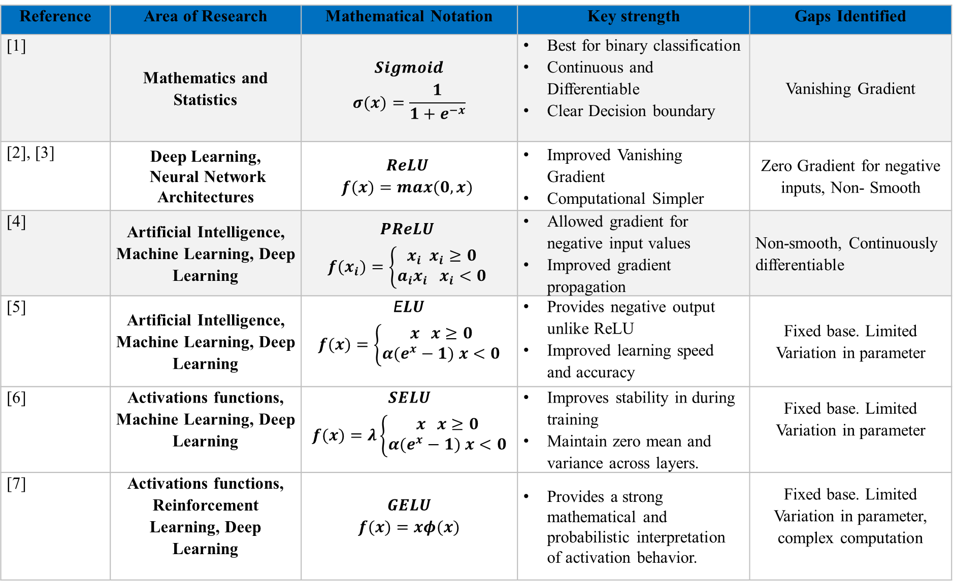
Reference | Area of Research | Mathematical Notation | Key strength | Gaps Identified
[1] | Mathematics and Statistics | $$Sigmoid$$ $$σ(x)=\frac{1}{1+e^{−x}}$$ | Best for binary classification Continuous and Differentiable Clear Decision boundary | Vanishing Gradient
[2], [3] | Deep Learning, Neural Network Architectures | $$ReLU$$ $$f(x)=max(0,x)$$ | Improved Vanishing Gradient Computational Simpler | Zero Gradient for negative inputs, Non- Smooth
[4] | Artificial Intelligence, Machine Learning, Deep Learning | $$PReLU$$ $$f(x_{i})=\left\{\begin{aligned}x_{i} x_{i}≥0 \\ a_{i}x_{i} x_{i}<0\end{aligned}\right.$$ | Allowed gradient for negative input values Improved gradient propagation | Non-smooth, Continuously differentiable
[5] | Artificial Intelligence, Machine Learning, Deep Learning | E$LU$ $$f(x)=\left\{\begin{aligned}x x≥0 \\ α(e^{x}−1) x<0\end{aligned}\right.$$ | Provides negative output unlike ReLU Improved learning speed and accuracy | Fixed base. Limited Variation in parameter
[6] | Activations functions, Machine Learning, Deep Learning | $$SELU$$ $$f(x)=λ\left\{\begin{aligned}x x≥0 \\ α(e^{x}−1) x<0\end{aligned}\right.$$ | Improves stability in during training Maintain zero mean and variance across layers. | Fixed base. Limited Variation in parameter
[7] | Activations functions, Reinforcement Learning, Deep Learning | $$GELU$$ $$f(x)=xφ(x)$$ | Provides a strong mathematical and probabilistic interpretation of activation behavior. | Fixed base. Limited Variation in parameter, complex computation

Slide 12
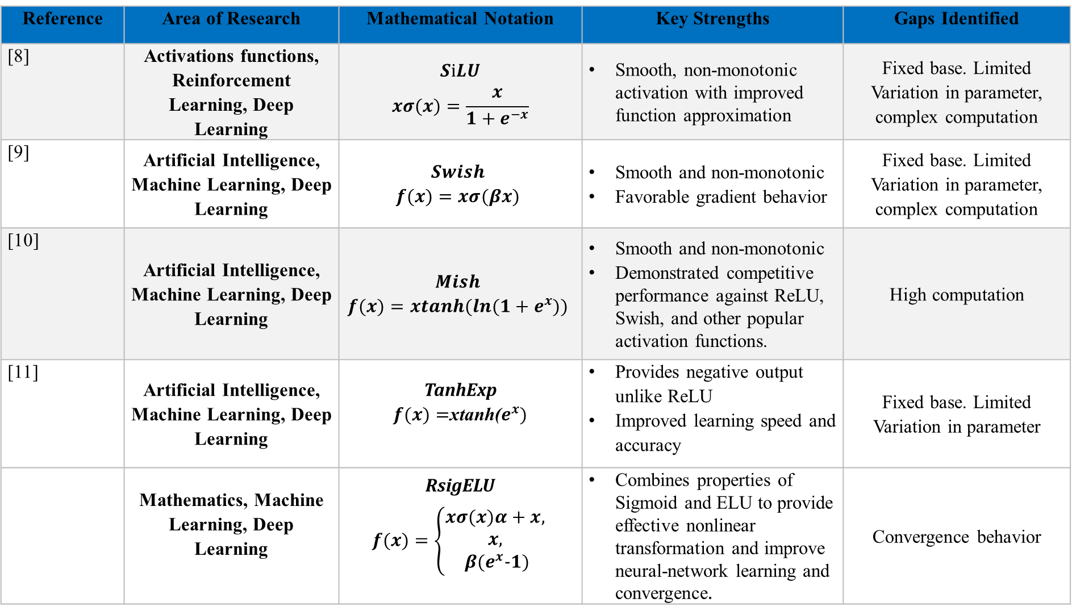
Reference | Area of Research | Mathematical Notation | Key Strengths | Gaps Identified
[8] | Activations functions, Reinforcement Learning, Deep Learning | $$SiLU$$ $$xσ(x)=\frac{x}{1+e^{−x}}$$ | Smooth, non-monotonic activation with improved function approximation | Fixed base. Limited Variation in parameter, complex computation
[9] | Artificial Intelligence, Machine Learning, Deep Learning | $$Swish$$ $$f(x)=xσ(βx)$$ | Smooth and non-monotonic Favorable gradient behavior | Fixed base. Limited Variation in parameter, complex computation
[10] | Artificial Intelligence, Machine Learning, Deep Learning | $$Mish$$ $$f(x)=xtanh(ln(1+e^{x}))$$ | Smooth and non-monotonic Demonstrated competitive performance against ReLU, Swish, and other popular activation functions. | High computation
[11] | Artificial Intelligence, Machine Learning, Deep Learning | TanhExp $f(x)=$xtanh($e^{x})$ | Provides negative output unlike ReLU Improved learning speed and accuracy | Fixed base. Limited Variation in parameter
 | Mathematics, Machine Learning, Deep Learning | RsigELU $$f(x)=\left\{\begin{aligned}xσ(x)α+x, \\ x, \\ β(e^{x}-1)\end{aligned}\right.$$ | Combines properties of Sigmoid and ELU to provide effective nonlinear transformation and improve neural-network learning and convergence. | Convergence behavior

Slide 13
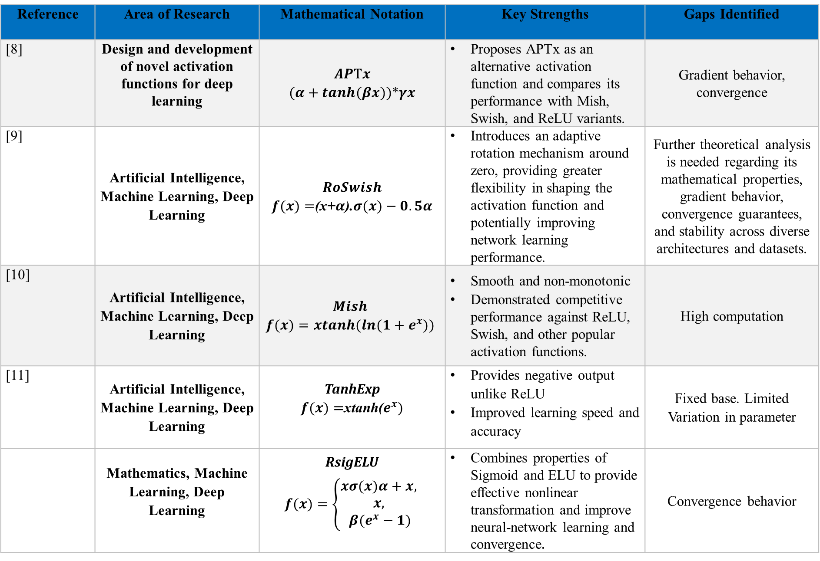
Reference | Area of Research | Mathematical Notation | Key Strengths | Gaps Identified
[8] | Design and development of novel activation functions for deep learning | $$APTx$$ $$(α+tanh(βx))*γx$$ | Proposes APTx as an alternative activation function and compares its performance with Mish, Swish, and ReLU variants. | Gradient behavior, convergence
[9] | Artificial Intelligence, Machine Learning, Deep Learning | $$RoSwish$$ $f(x)=$(x+$α$).$σ(x)−0.5α$ | Introduces an adaptive rotation mechanism around zero, providing greater flexibility in shaping the activation function and potentially improving network learning performance. | Further theoretical analysis is needed regarding its mathematical properties, gradient behavior, convergence guarantees, and stability across diverse architectures and datasets.
[10] | Artificial Intelligence, Machine Learning, Deep Learning | $$Mish$$ $$f(x)=xtanh(ln(1+e^{x}))$$ | Smooth and non-monotonic Demonstrated competitive performance against ReLU, Swish, and other popular activation functions. | High computation
[11] | Artificial Intelligence, Machine Learning, Deep Learning | TanhExp $f(x)=$xtanh($e^{x})$ | Provides negative output unlike ReLU Improved learning speed and accuracy | Fixed base. Limited Variation in parameter
 | Mathematics, Machine Learning, Deep Learning | RsigELU $$f(x)=\left\{\begin{aligned}xσ(x)α+x, \\ x, \\ β(e^{x}−1)\end{aligned}\right.$$ | Combines properties of Sigmoid and ELU to provide effective nonlinear transformation and improve neural-network learning and convergence. | Convergence behavior

Slide 14
Research gaps identified
Neural Networks are machine learning models inspired by the way the human brain processes information.
They consist of interconnected layers of neurons that learn patterns from data and make predictions.
A neuron receives inputs, applies weights and bias, and produces an output.
Deep neural networks (DNNs) contain multiple hidden layers for learning complex patterns.
Neural networks are widely used for classification, prediction, and pattern recognition.

Slide 15
Problem Statement

Slide 16

Objectives of the research study

Slide 17
Research Questions

Slide 18
methodology

Slide 19
methodology
Source: ..\thesis data.xlsx

Slide 20
Proposed Results & discussion

Slide 21
discussion

Slide 22
discussion

Slide 23
discussion

Slide 24
Contribution

Slide 25
limitations
Causal relationships cannot be established.
Mental health may be underreported due to stigma and reporting bias.
Important clinical, psychosocial, and biological factors were not available.
Low-prevalence disorders remained difficult to predict despite ROSE balancing.

Slide 27
REFERENCES

Slide 28
REFERENCES

Slide 29
Thank you

